Slide 1
21CS703
DATA ANALYTICS (Lab Integrated)
Prepare by
Dr. A. GNANASEKAR
Associate Professor
Department of Computer Science & Engineering
R.M.D. Engineering College

Slide 2
UNIT 3 -EXPLORATORY DATA ANALYSIS
Exploratory Data Analysis (EDA) is the process of examining and understanding data before applying advanced statistical or machine learning methods.

Slide 3
UNIT 3 -EXPLORATORY DATA ANALYSIS
Key Objectives of EDA
Understand the structure of data – number of rows, columns, types of variables.
Summarize key statistics – mean, median, mode, min, max, standard deviation.
Detect missing values
Identify relationships between variables.
Check assumptions for modeling (normality, linearity)

Slide 4
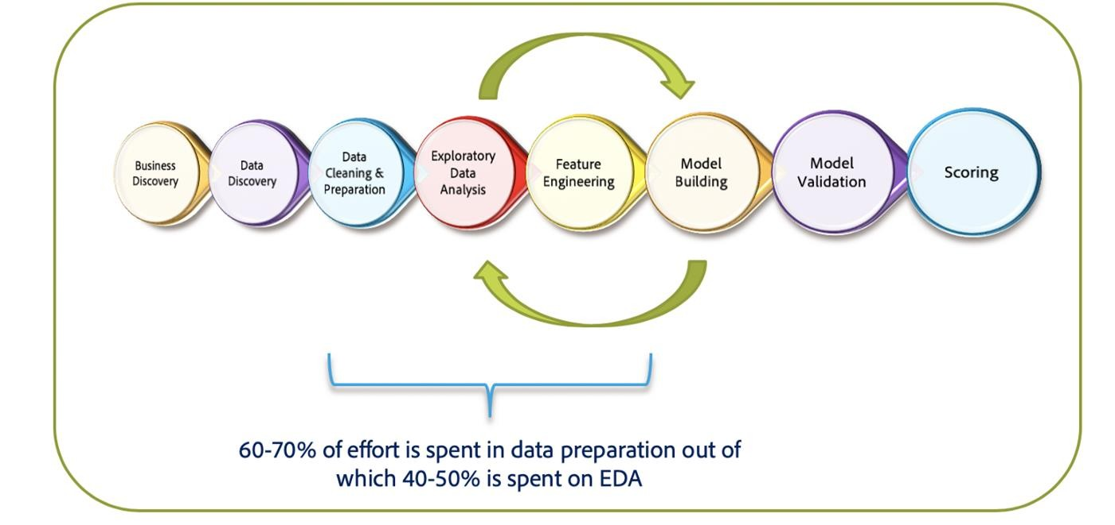
UNIT 3 -EXPLORATORY DATA ANALYSIS

Slide 5
UNIT 3 -EXPLORATORY DATA ANALYSIS
Steps in EDA
Data Collection & Loading
  Import datasets from CSV, Excel, SQL, or other sources.
Data Cleaning
  Handle missing values.
  Remove duplicates.
  Correct data types (int, float, categorical).
Univariate Analysis (one variable at a time)
  Numerical: histograms, boxplots, density plots.
  Categorical: bar charts, frequency tables.

Slide 6
UNIT 3 -EXPLORATORY DATA ANALYSIS
Steps in EDA
4.Bivariate/Multivariate Analysis
  Scatter plots, correlation heatmaps, pairplots.
  Grouped statistics by category.
5. Outlier Detection
  Boxplots, z-scores, IQR method.
6. Feature Engineering (optional)
  Creating new variables.
  Encoding categorical features.
  Normalization/standardization.

Slide 7
UNIT 3 – Types of EDA Techniques
Univariate Analysis
Definition: Focuses on analyzing a single variable at a time.
Techniques:
  Descriptive statistics (mean, median, mode, variance, standard deviation).
  Visualizations (histograms, box plots, bar charts, pie charts).

Slide 8
Types of EDA Techniques
2. Bivariate Analysis
Definition: Examines the relationship between two variables.
Techniques:
  Scatter plots.
  Correlation coefficients (Pearson, Spearman).
  Cross-tabulations and contingency tables.
  Visualizations (line plots, scatter plots, pair plots).

Slide 9
Types of EDA Techniques
3. Multivariate Analysis
Definition: Investigates interactions between three or more variables.
Techniques:
  Multivariate plots (pair plots, parallel coordinates plots).
  Dimensionality reduction techniques (PCA, t-SNE).
  Cluster analysis.
  Heatmaps and correlation matrices.

Slide 10
Types of EDA Techniques
4. Descriptive Statistics
Definition: Summarizes the main features of a data set.
Techniques:
  Measures of central tendency (mean, median, mode).
  Measures of dispersion (range, variance, standard deviation).
  Frequency distributions.

Slide 11
Types of EDA Techniques
5. Graphical Analysis
Definition: Uses visual tools to explore data.
Purpose: To identify patterns, trends, and data anomalies through visualization.
Techniques:
  Charts (bar charts, histograms, pie charts).
  Plots (scatter plots, line plots, box plots).
  Advanced visualizations (heatmaps, violin plots, pair plots).

Slide 12
UNIT 3 –Understanding data science
Data Science is the field of extracting meaningful insights and knowledge from data using a combination of:
    1. Mathematics & Statistics
    2. Programming (Python, R, SQL, etc.)
    3. Domain Knowledge (understanding the business problem)
    4. Machine Learning & AI
It’s about turning raw data into actionable insights that help in decision-making.

Slide 13
UNIT 3 –Understanding data science
Here’s the typical process:
1. Data Collection
  Gather data from databases, APIs, files, sensors, etc.
  Example: Collect sales data, website logs, or sensor readings.
2. Data Cleaning & Pre-processing
  Handle missing values, duplicates, noise.
  Convert categorical values (e.g., One-Hot Encoding).
  Example: Filling missing ages in a customer dataset.
3. Exploratory Data Analysis (EDA)
  Visualize and understand patterns, correlations, and trends.
  Example: Plot sales over time, check correlation between income and spending.

Slide 14
UNIT 3 –Understanding data science
4. Feature Engineering
Create new useful features from existing ones.
Example: From "Year Built" → create "House Age".
5. Model Building (Machine Learning / AI)
Apply algorithms (Regression, Classification, Clustering, etc.).
Example: Predict house prices using regression.
6. Model Evaluation
Check accuracy, precision, recall, etc.
Example: Test how well a model predicts customer churn.

Slide 15
UNIT 3 –Understanding data science
7. Deployment
Put the model into production (e.g., a recommendation system in an e-commerce site).
8. Monitoring & Improvement
Continuously monitor performance and update with new data.

Slide 16

UNIT 3 – Steps in EDA
Steps to Perform EDA in Python
1. Importing Libraries
To perform EDA, you need to import essential libraries such as Pandas, NumPy, Matplotlib, and Seaborn
2. Loading the Data
Load your dataset into a Pandas DataFrame.

Slide 17

UNIT 3 – Steps in EDA
Steps to Perform EDA in Python
3. Initial Inspection
Get an overview of the data using methods like head(), tail(), and info().
These methods help you understand the structure, data types, and missing values in the dataset.

Slide 18
UNIT 3 – Steps in EDA
Steps to Perform EDA in Python
4. Data Cleaning
Identify and handle missing values using methods like isnull().sum() and fillna().
You can also remove duplicates using drop_duplicates().

Slide 19
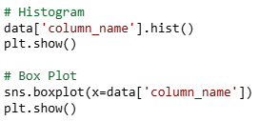
UNIT 3 – Steps in EDA
Steps to Perform EDA in Python
5. Univariate Analysis
Analyze single variables at a time using descriptive statistics and visualizations.
Use histograms, box plots, and density plots to visualize distributions.

Slide 20
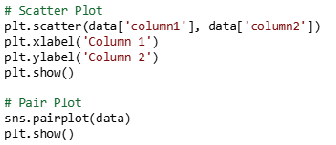
UNIT 3 – Steps in EDA
Steps to Perform EDA in Python
6. Bivariate Analysis
Explore relationships between two variables using scatter plots, pair plots, and correlation matrices.

Slide 21

UNIT 3 – Steps in EDA
Steps to Perform EDA in Python
7. Multivariate Analysis
Analyze interactions between three or more variables using techniques like heatmaps and correlation matrices.

Slide 22

UNIT 3 – Steps in EDA
Steps to Perform EDA in Python
8. Feature Engineering
Create new features from existing data to improve the performance of your models.
This can include creating new columns, transforming variables, and encoding categorical variables.

Slide 23
UNIT 3 – Steps in EDA
Steps to Perform EDA in Python
9. Data Transformation
Transform variables to normalize the data and handle skewness.
Log transformation is a common technique used for this purpose.

Slide 24
UNIT 3 – Steps in EDA
Steps to Perform EDA in Python
10. Impute Missing Values
Impute missing values using techniques like mean, median, or mode imputation.
Advanced methods like KNN imputation can also be used.

Slide 25
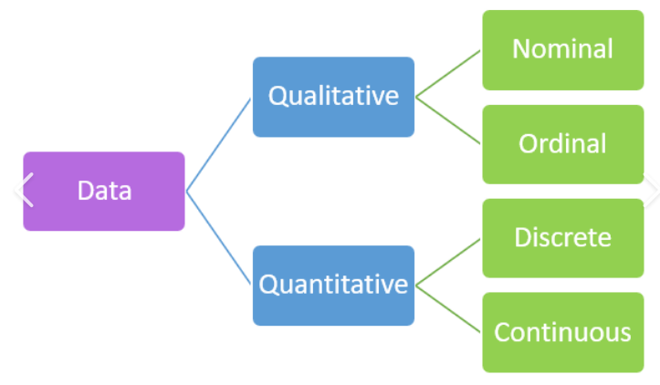
UNIT 3 – Making sense of data
Qualitative data refers to non-numerical information that describes qualities, characteristics, or attributes. ( not Measured)
Quantitative data refers to numerical information that can be measured and expressed with numbers.

Slide 26
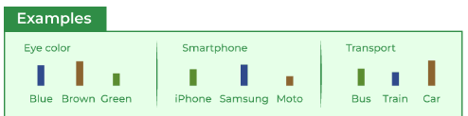
UNIT 3 – Making sense of data
Types of Qualitative Data:
Nominal Data
Categories without order, no meaningful (e.g., gender, religion, blood group, colors).
👉 Example:
A person’s eye color (brown, blue, green).

Slide 27
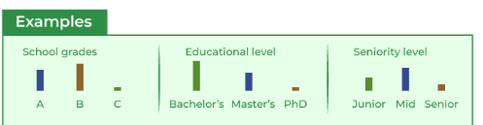
UNIT 3 – Making sense of data
Ordinal Data
Categories with a meaningful order/ranking (e.g., feedback levels like poor, average, good, excellent).
👉 Example:
A student’s grade (A, B, C).
A customer’s feedback (“satisfied”, “unsatisfied”).

Slide 28
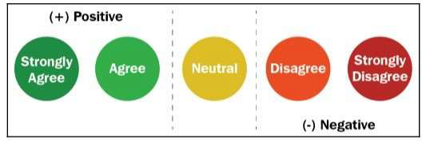
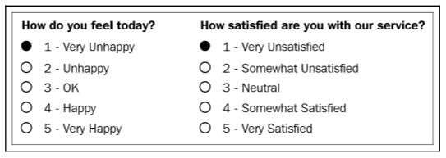
UNIT 3 – Making sense of data
Ordinal Data

Slide 29
UNIT 3 – Making sense of data
Types of Quantitative Data:
Discrete Data – Countable values (e.g., number of students in a class, number of cars).
👉 Example:
A student scored 85 marks in mathematics.
Continuous Data – Measurable values within a range (e.g., height, weight, temperature, time).
👉 Example:
The classroom temperature is 28.5°C.

Slide 30
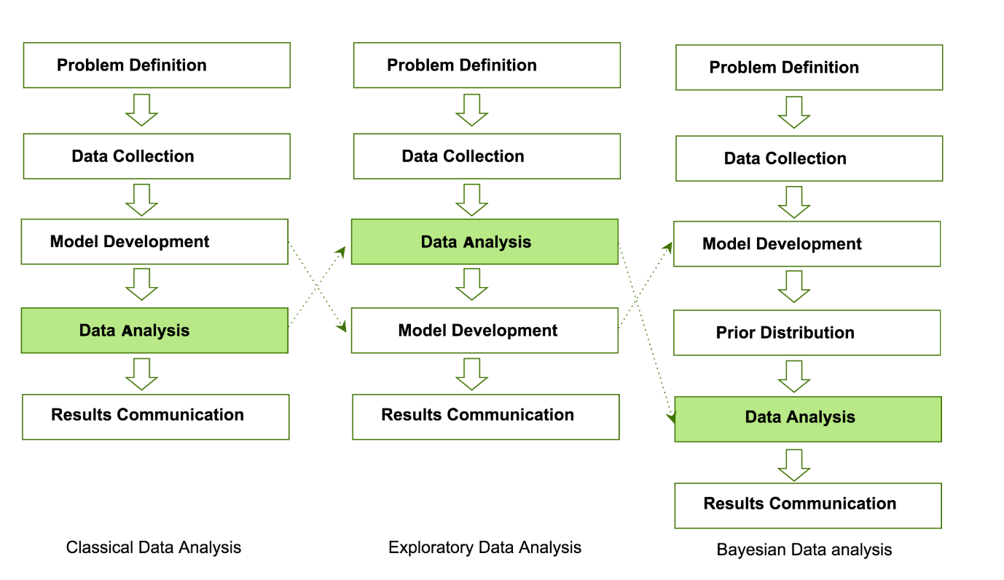
Comparing EDA with classical and Bayesian analysis

Slide 31
Software tools for EDA
1.Python Libraries
1. Data Handling
NumPy → For numerical operations, arrays, linear algebra.
Pandas → For data manipulation and analysis (DataFrames, Series).
2. Data Visualization
Matplotlib → For basic plotting (line, bar, scatter plots).
Seaborn → For statistical visualizations (heatmaps, pair plots).
Plotly → For interactive and dynamic visualizations.

Slide 32
Software tools for EDA
1. Python Libraries
3. Machine Learning & AI
Scikit-learn → For machine learning algorithms (classification, regression, clustering).
TensorFlow → For deep learning and neural networks.
PyTorch → For deep learning, flexible model building.
4. Data Collection & Processing
OpenCV → For computer vision and image processing.

Slide 33
Software tools for EDA
1. Python Libraries
5. Other Useful Libraries
NLTK / SpaCy → For natural language processing (NLP).
SQLite3 / SQLAlchemy → For database handling.
.

Slide 34
Software tools for EDA
2. R Libraries
1. Data Handling & Manipulation
dplyr → Data manipulation (filter, select, group, summarise).
tidyr → Data cleaning and reshaping.
data.table → Fast data manipulation with large datasets.
2. Data Visualization
ggplot2 → Widely used for creating customizable plots and charts.
plotly → Interactive visualizations.
lattice → Trellis graphs for multivariate data.

Slide 35
Software tools for EDA
2. R Libraries
3. Statistical Analysis
stats → Built-in R package for statistical tests.
MASS → Functions and datasets for applied statistics.
survival → For survival analysis.
4. Machine Learning & AI
caret → For classification and regression training.
randomForest → For random forest models..

Slide 36
Software tools for EDA
2. R Libraries
5. Text & Web Data
tm → Text mining.
stringr → String manipulation.
rvest → Web scraping.
6. Other Useful Libraries
shiny → For interactive web applications.
forecast → Time series forecasting.
lubridate → Date and time handling.

Slide 37
Software tools for EDA
3. Integrated Development Environments (IDEs)
Jupyter Notebook:
  An open-source web application that allows you to create and share documents that contain live code, equations, visualizations, and narrative text.
RStudio:
  An integrated development environment for R that offers tools for writing and debugging code, building software, and analyzing data.
  Use: R development and analysis.

Slide 38
Software tools for EDA
4. Data Visualization Tools
Tableau:
  A top data visualization tool that facilitates to create charts and dashboards.
  Power BI:
  A Microsoft business analytics service offering interactive visualizations and business intelligence features.
  Use: Interactive reports and dashboards.

Slide 39
Data Transformation Techniques
Data transformation is the process of converting raw data into a usable format for analysis, modeling, or storage.
It helps improve data quality, consistency, and interpretability.

Slide 40
Data Transformation Techniques
1. Data Cleaning
Handling missing values (imputation, removal, interpolation).
Removing duplicates.
Correcting inconsistent data (e.g., "M" vs "Male").

Slide 41
Data Transformation Techniques
2. Scaling
Adjusts the range of features.
Techniques:
    Min-Max Scaling → transforms values to [0,1].
    Standardization (Z-score) → mean = 0, std = 1.

Slide 42

Data Transformation Techniques
2. Scaling
1.Min-Max Scaling
This rescales values into the range [0, 1].
Example Dataset:
Original exam scores = [20, 50, 80, 100]
Minimum = 20
Maximum = 100

Slide 43
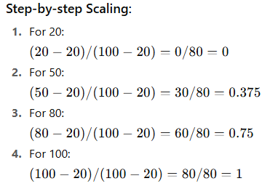
Data Transformation Techniques
Final Normalized Values:
Original → [20, 50, 80, 100]
Scaled → [0, 0.375, 0.75, 1]

Slide 44
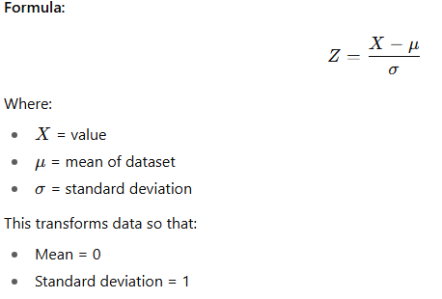
Data Transformation Techniques
2. Standardization (Z-score):
Converts data to mean = 0 and standard deviation = 1.

Slide 45
Data Transformation Techniques
Techniques: Standardization (Z-score):
Example Dataset:
Values = [10, 20, 30, 40, 50]
Mean (μ) = (10+20+30+40+50)/5 = 30
Standard deviation (σ) ≈ 14.14

Slide 46
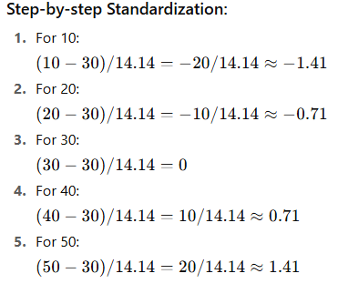
Data Transformation Techniques
Techniques:Standardization (Z-score):
Final Z-scores:
Original → [10, 20, 30, 40, 50]
Standardized → [-1.41, -0.71, 0, 0.71, 1.41]

Slide 47
Data Transformation Techniques
3. Encoding Categorical Data
Converts categorical → numeric.
Label Encoding
Assigns numbers to categories
Example Data set:
Fruit = ["Apple", "Banana", "Orange", "Apple", "Orange"]
Step-by-step Encoding:
Apple → 0
Banana → 1
Orange → 2
Encoded Values:
["Apple", "Banana", "Orange", "Apple", "Orange"]
↓
[0, 1, 2, 0, 2]

Slide 48
Data Transformation Techniques
3. Encoding Categorical Data
2. One-Hot Encoding
It is a technique used to convert categorical values into a binary vector representation
only one "1" is hot, rest are "0".
Example:
Suppose you have a feature "Color" with 3 possible categories: Red, Green, Blue

Slide 49
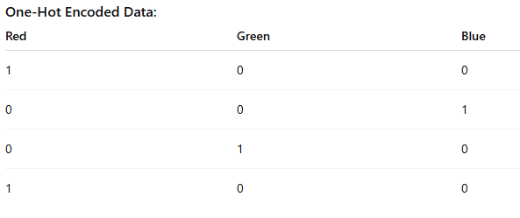
Data Transformation Techniques
3. Encoding Categorical Data
2. One-Hot Encoding
Orginal Data: Colors
Red
Blue
Green
Red

Slide 50
Data Transformation Techniques
4. Binning / Discretization
Converts continuous variables into categories / bins
Example: Age → [0–12: Child, 13–19: Teen, 20–59: Adult, 60+: Senior].
Example:
Suppose you have students’
ages: [5, 12, 17, 19, 24, 32, 45, 52, 61, 77]

Slide 51
Data Transformation Techniques
4. Binning / Discretization
Example:
Suppose you have students’
ages: [5, 12, 17, 19, 24, 32, 45, 52, 61, 77]
Step 1: Define bins
We divide ages into 4 bins:
Child (0–12)
Teen (13–19)
Adult (20–59)
Senior (60+)

Slide 52
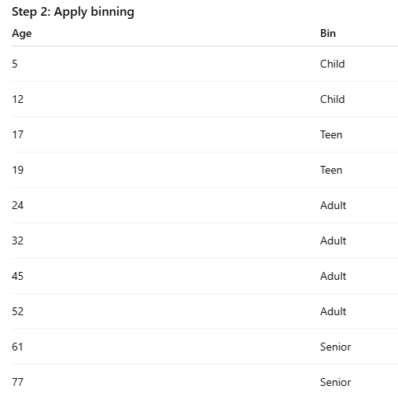
Data Transformation Techniques
4. Binning / Discretization

Slide 53
Data Transformation Techniques
5. Log / Power Transformations
Applies log to compress large values.
Reduces skewness and stabilizes variance.
Example: Income, sales, population counts.
Example Data:
Suppose you have income values (highly skewed data):
[1000, 2000, 5000, 10000, 50000, 100000]

Slide 54
Data Transformation Techniques
5. Log / Power Transformations
Example Data:
Suppose you have income values (highly skewed data):
[1000, 2000, 5000, 10000, 50000, 100000]
Log Transformation (log base 10): (Log Transformation)
log10([1000, 2000, 5000, 10000, 50000, 100000])
=[3, 3.3, 3.7, 4, 4.7, 5]
Compresses large values and reduces skewness.

Slide 55
Data Transformation Techniques
5. Log / Power Transformations
Example Data:
Suppose you have income values (highly skewed data):
[1000, 2000, 5000, 10000, 50000, 100000].
2. Square Root Transformation: (power Transformation)
sqrt([1000, 2000, 5000, 10000, 50000, 100000])
≈ [31.6, 44.7, 70.7, 100, 223.6, 316.2]
Compresses large values and reduces skewness.

Slide 56
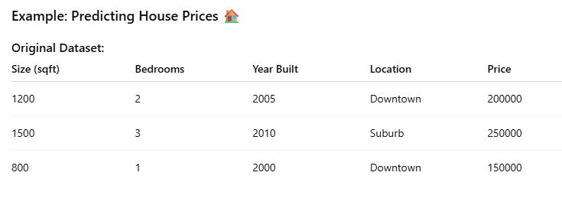
Data Transformation Techniques
6. Feature Engineering
Create new features by transforming existing ones.
Examples:
Ratios (Price per Sqft, BMI).
Polynomial features (x², x³).

Slide 57
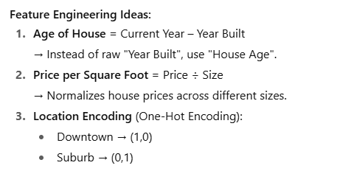
Data Transformation Techniques
6. Feature Engineering

Slide 58
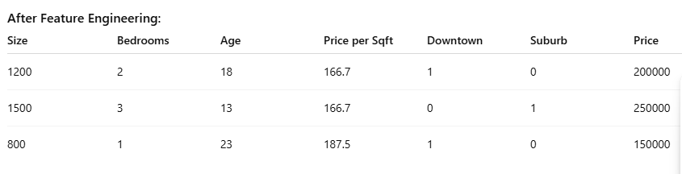
Data Transformation Techniques
6. Feature Engineering
By creating better, more informative features, the model can learn patterns more effectively.

Slide 59
Data Transformation Techniques
7. Aggregation & Grouping
Aggregation means summarizing data (e.g., sum, average, count).
Grouping means organizing data based on categories before applying aggregation.
Summarize data into meaningful features.
Example: Total sales per customer, average order value.

Slide 60
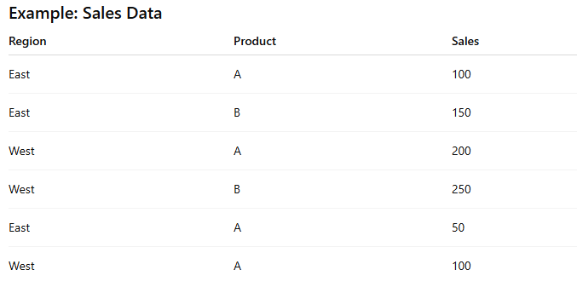
Data Transformation Techniques
7. Aggregation & Grouping

Slide 61
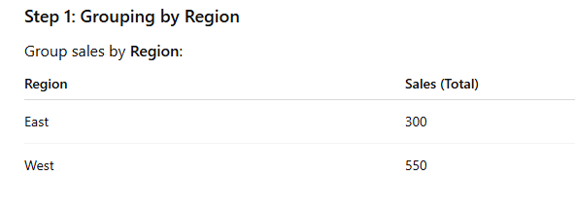
Data Transformation Techniques
7. Aggregation & Grouping

Slide 62
Data Transformation Techniques
8. Dimensionality Reduction
Dimensionality Reduction is the process of reducing the number of input features (dimensions) while keeping as much important information as possible.
Techniques: PCA (Principal Component Analysis), LDA (Linear Discriminant Analysis).

Slide 63
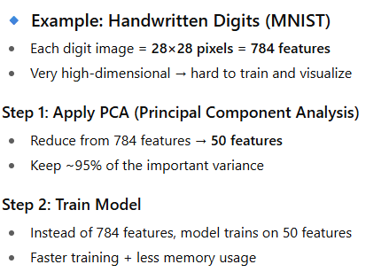
Data Transformation Techniques
8. Dimensionality Reduction

Slide 64
Data Transformation Techniques
8. Dimensionality Reduction
Popular Dimensionality Reduction Techniques:
PCA (Principal Component Analysis) → Linear technique
LDA (Linear Discriminant Analysis) → For classification problems
t-SNE → Nonlinear, great for visualization of clusters
UMAP → Faster than t-SNE, preserves local + global structure

Slide 65
Data Transformation Techniques
9. Data Integration & Consolidation
Data Integration:
Combining data from multiple sources into a single, unified view.
Data Consolidation:
Merging, cleaning, and standardizing that integrated data so it’s consistent and usable.

Slide 66
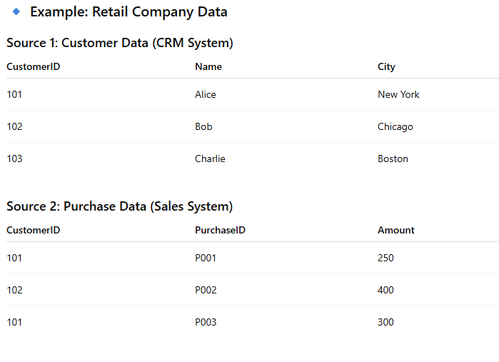
Data Transformation Techniques
9. Data Integration & Consolidation

Slide 67
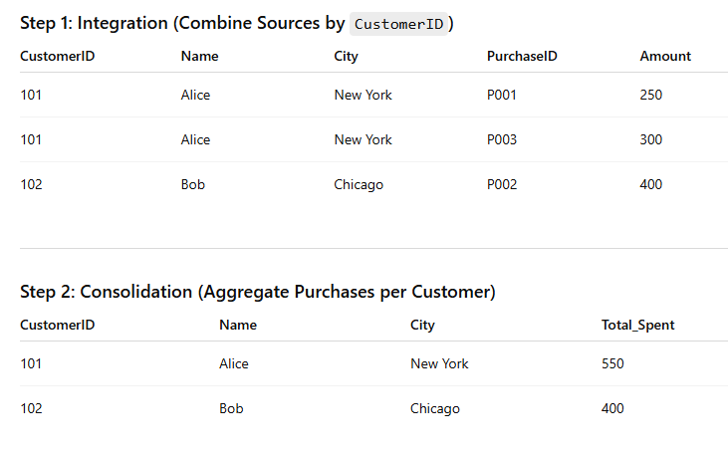
Data Transformation Techniques
9. Data Integration & Consolidation

Slide 68
UNIT 3 – NO SQL
Some say the term “NoSQL” stands for “non SQL” while others say it stands for “not only SQL.”
These are non-relational, open-source, distributed databases
NoSQL databases are databases that store data in a format other than relational tables.

Slide 69
UNIT 3 – Characteristics of NO SQL
Schema free
Eventually consistent (as in the BASE property) (Basically Available, Soft State, and Eventual Consistency)
CAP Theorem: Consistency, Availability, and Partition Tolerance.
Replication of data stores to avoid Single Point of Failure.
Can handle Data variety and huge amounts of data.

Slide 70
UNIT 3 – Special Features of NO SQL
Are Non-relational data storage systems
Are No fixed table schema
Are Distributed
No joins
No multi-document transaction
Release one or more ACID properties. (CAP Properties)

Slide 71
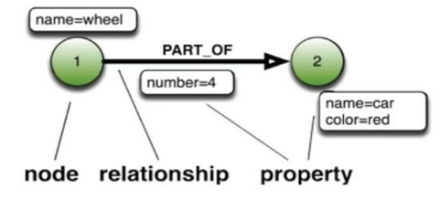
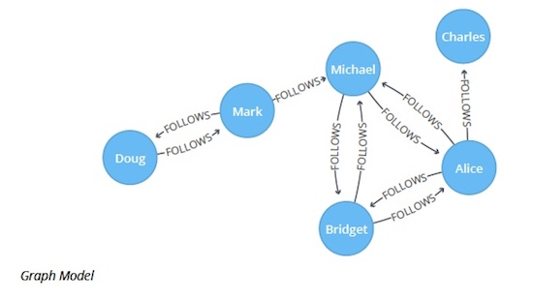
UNIT 3 – NO SQL Types
1. Graph Databases:
Graph-oriented
It is designed to store and navigate relationships between data. Instead of tables or documents, it uses nodes, edges, and properties..
Graph Databases: Amazon Neptune, Neo4j, OrientDB

Slide 72
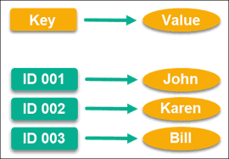
UNIT 3 – NO SQL Types
2. Key value Store:
The Key-Value Store Data Model is also very similar to the RDBMS structure.
In a Key-Value Store Data Model, we have a key in the left side and a value in the right side.
Key-valueue store: Memcached, Redis, Coherence

Slide 73
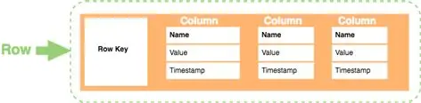
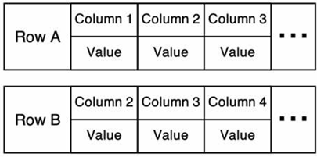
UNIT 3 – NO SQL Types
3. Wide-column stores:
NoSQL database that organizes data into rows and dynamic columns, but unlike relational databases, each row doesn’t need to have the same columns.
Tables → Rows → Columns (similar to RDBMS, but more flexible).
The Row key identifies the row consisting of multiple columns.
Wide Column Stores: Apache Cassandra and HBase.

Slide 74
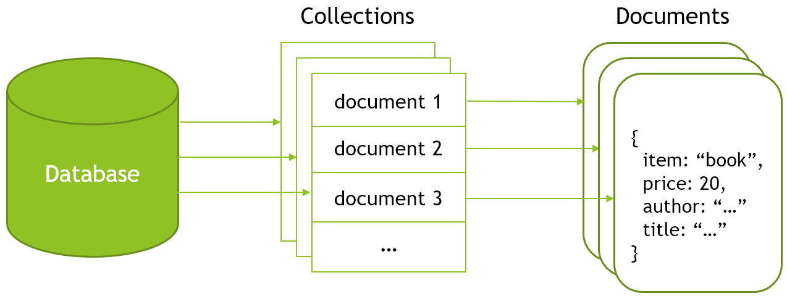
UNIT 3 – NO SQL Types
4. Document-based:
‌Document stores use JSON, XML documents to store data.
It is like a key-value database, but a document store consists of semi-structured data.
A single document is to store records and its data.
‌It does not support relations or joins.
Document-based: MongoDB, CouchDB, Cloudant

Slide 75
Advantages of NoSQL
Handle large volumes of data at high speed with a scale-out architecture
Store unstructured, semi-structured, or structured data
Be developer-friendly

Slide 76
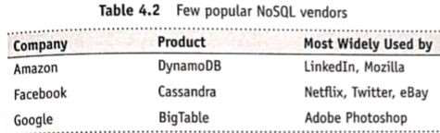
NoSQL Vendors

Slide 77
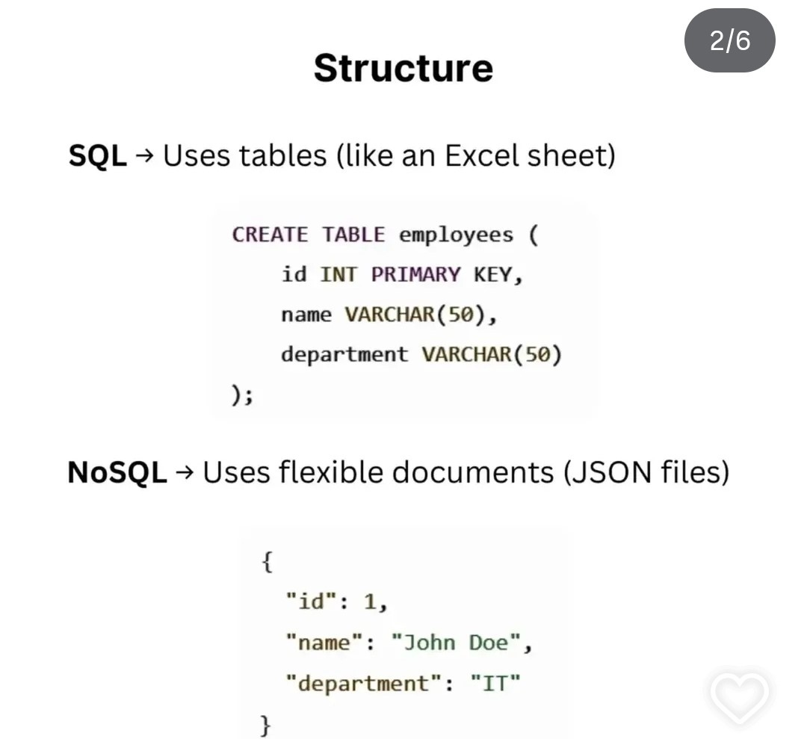
SQL vs NoSQL

Slide 78
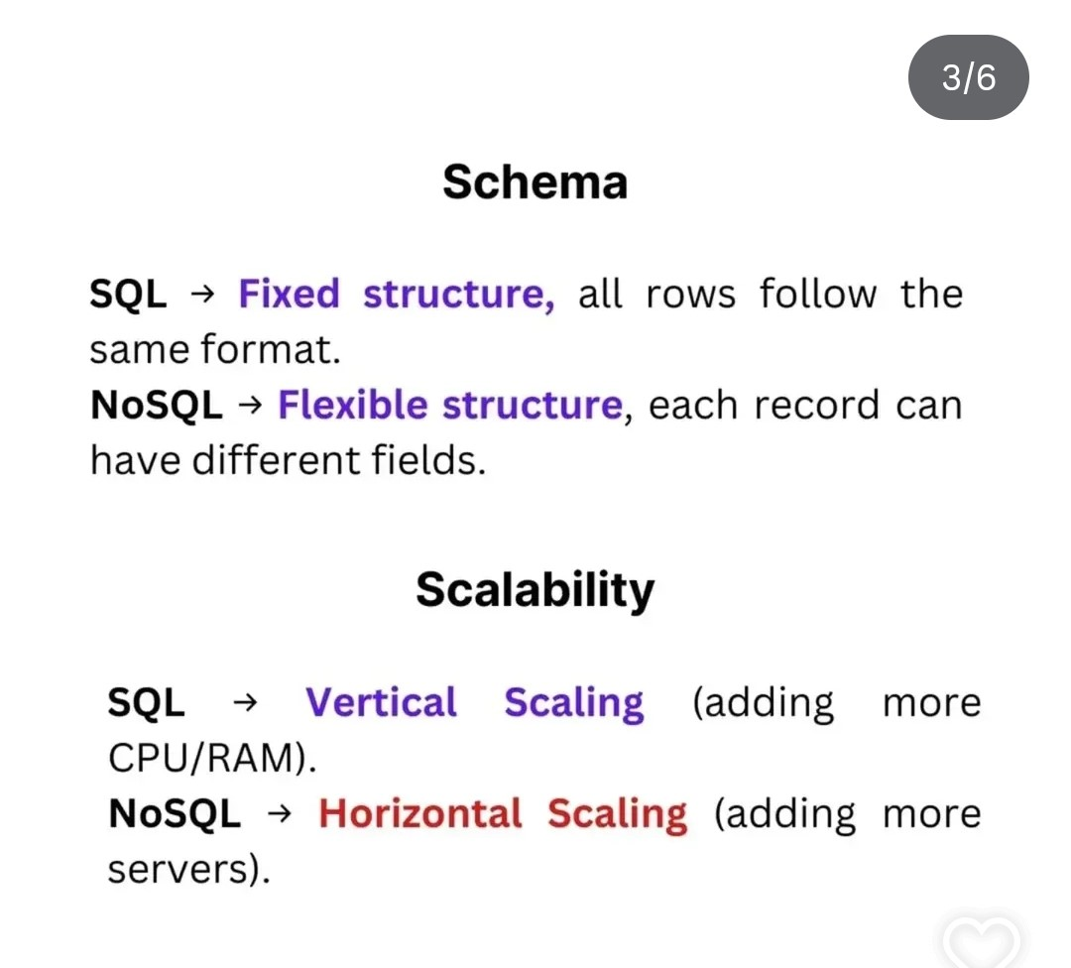
SQL vs NoSQL

Slide 79
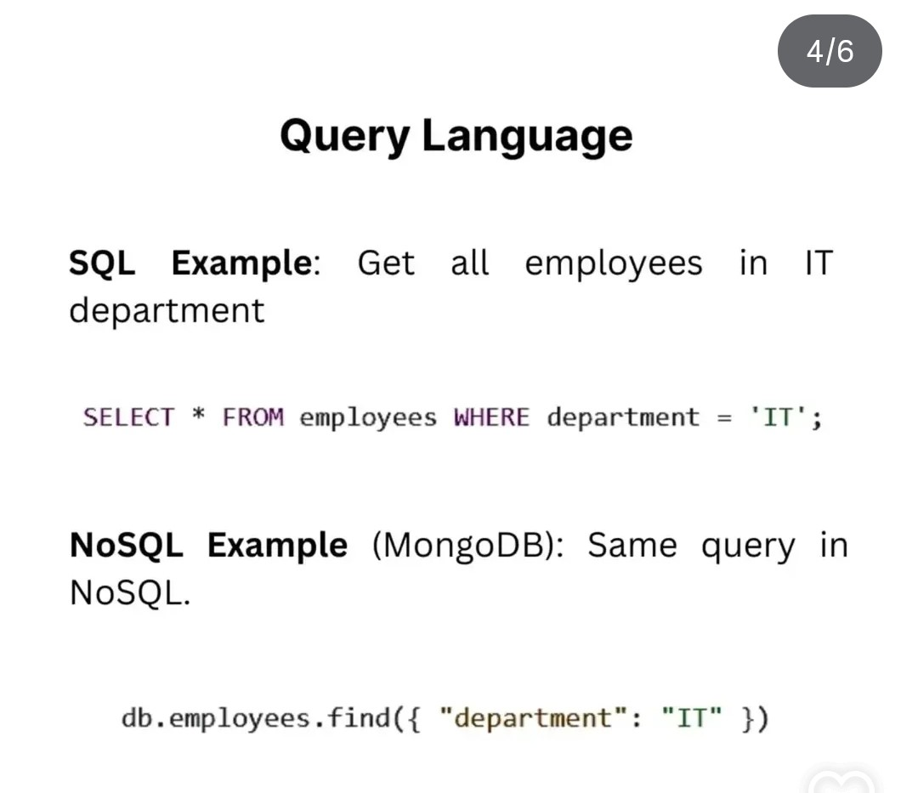
SQL vs NoSQL

Slide 80
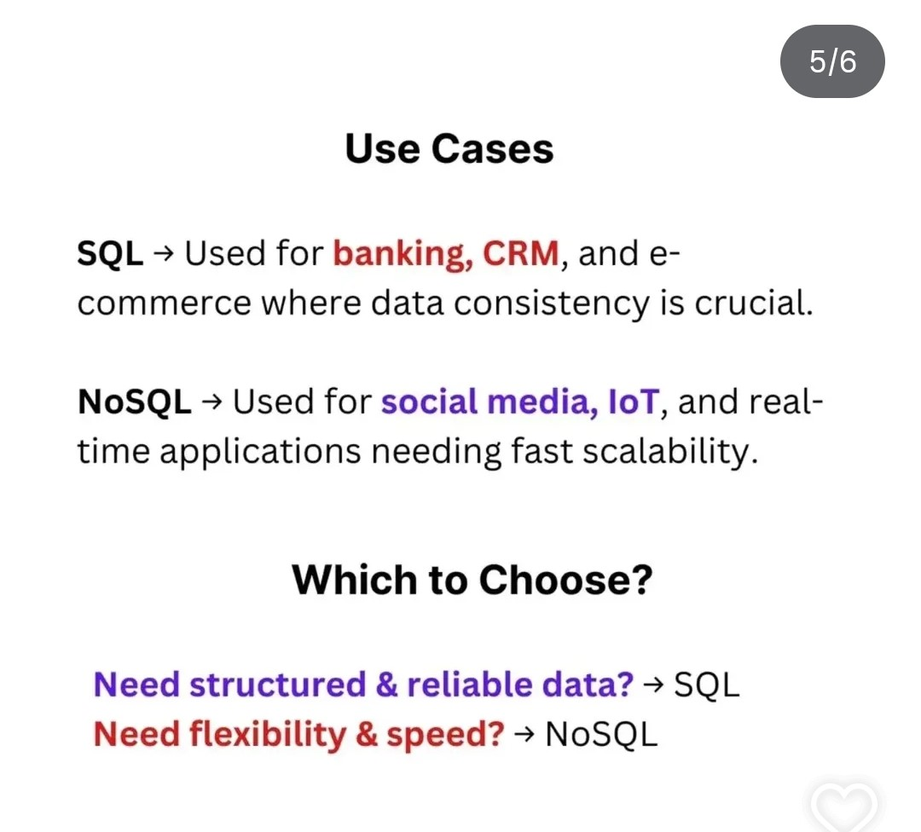
SQL vs NoSQL

Slide 81
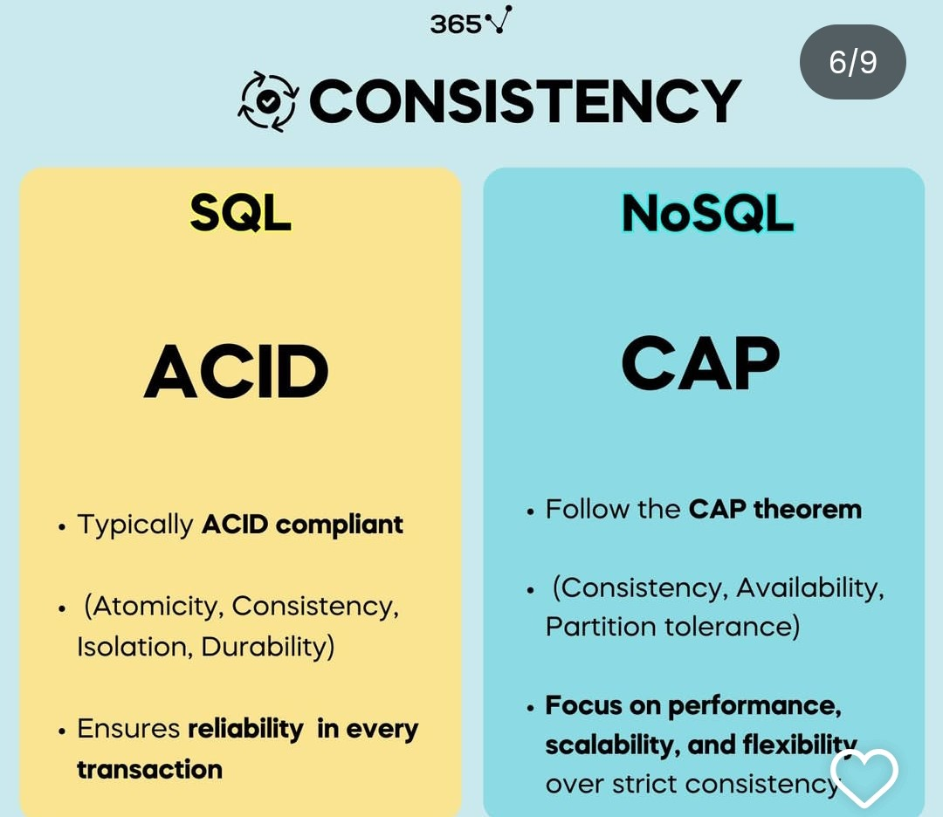
SQL vs NoSQL

Slide 82
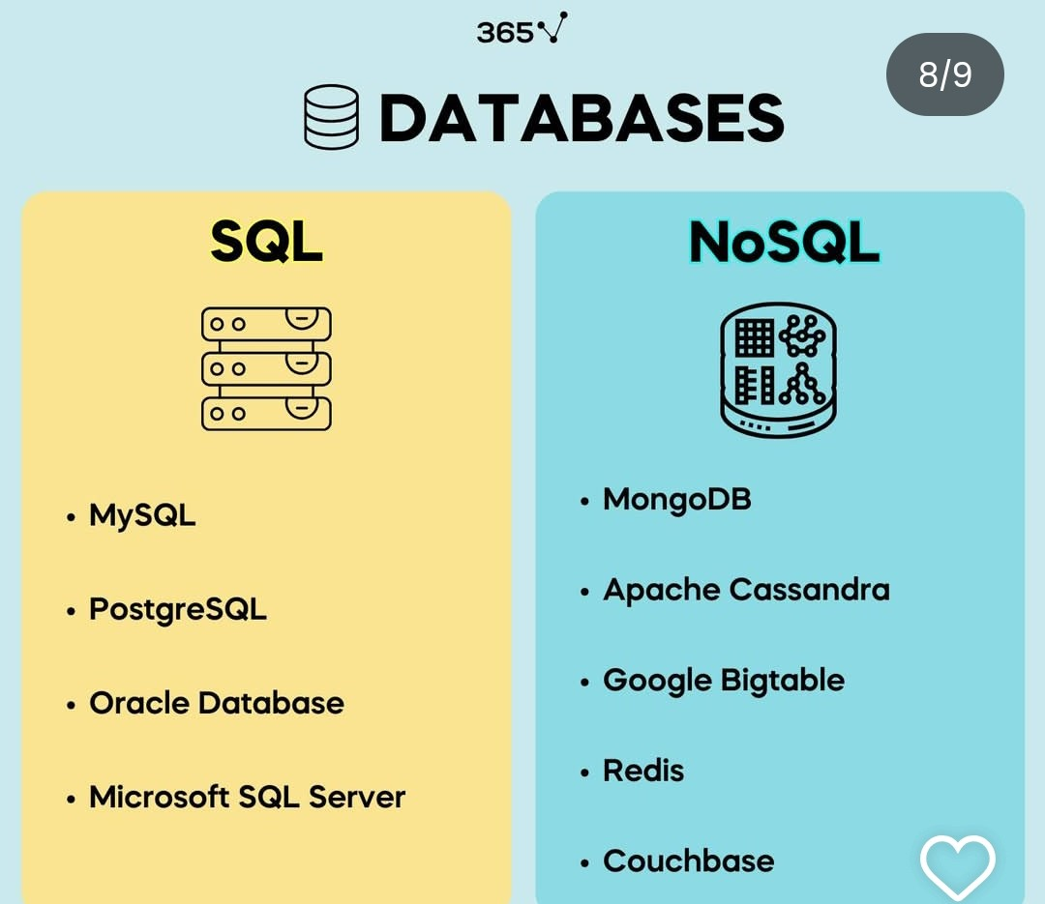
SQL vs NoSQL

Slide 83
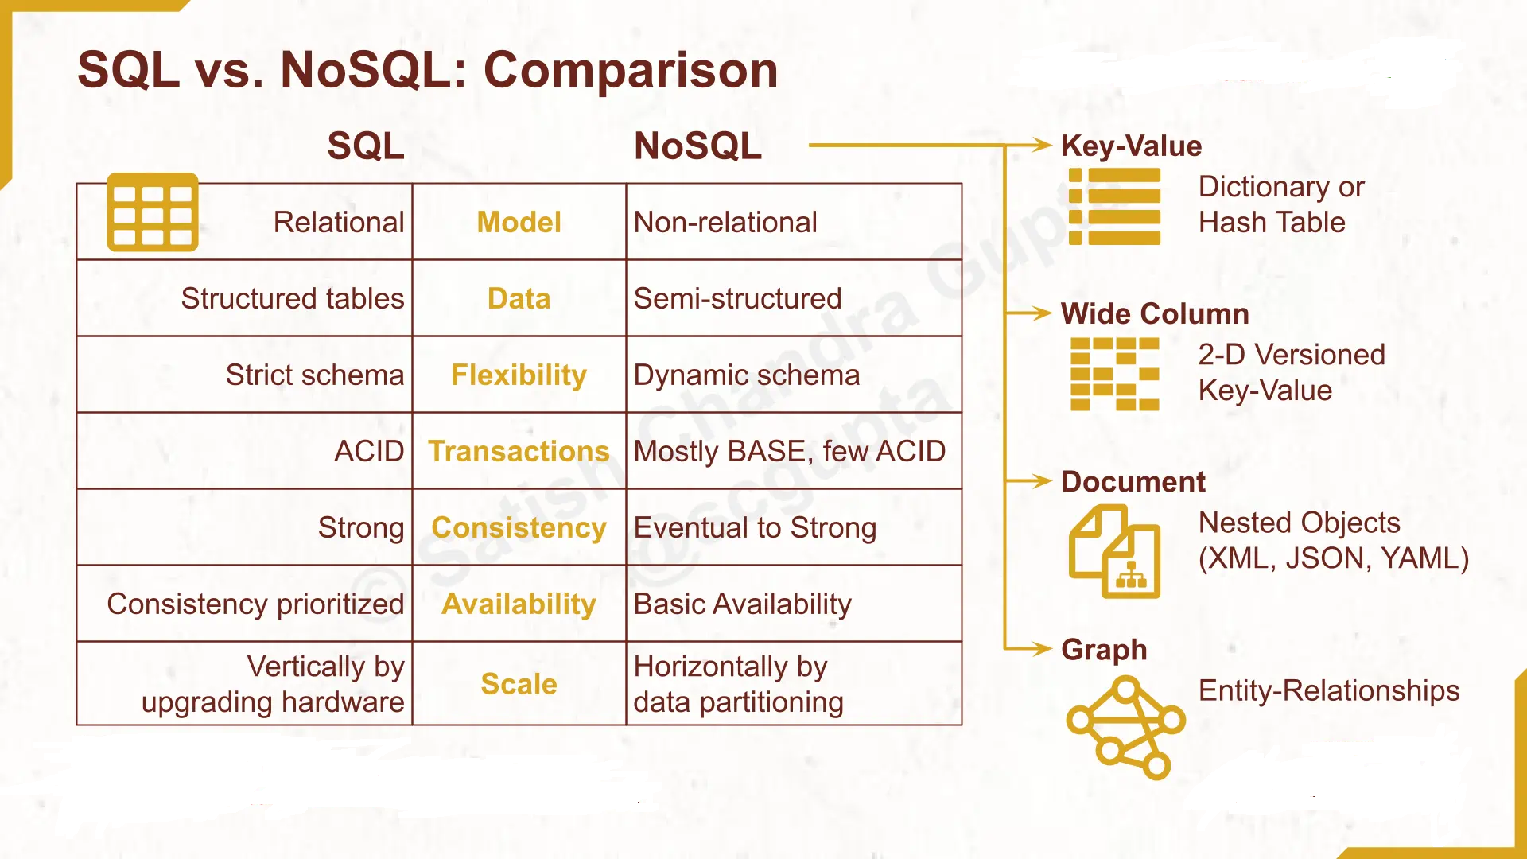
SQL vs NoSQL

Slide 84
MongoDB
MongoDB is the most popular document-based NoSQL database. It stores data as documents in a JSON-like format (BSON internally).
MongoDB is
1.Cross-platform.
2.Open source.
3.Non-relational.
4.Distributed.
5.NoSQL.
6.Document-oriented datastore

Slide 85
MongoDB
The structure of JSON objects.
      {
      title: "Post Title 1",
      body: "Body of post.",
      category: "News",
      likes: 1,
      tags: ["news", "events"],
      date: Date()
      }

Slide 86
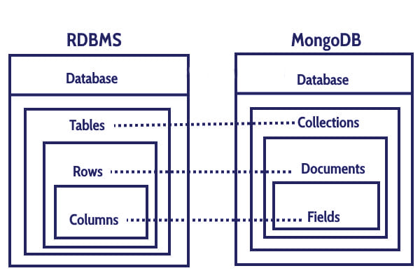
TERMS USED IN RDBMS AND MONGODB

Slide 87
RDBMS vs MONGODB
Aspect | RDBMS | MongoDB
Data Model | Structured data in tables (rows & columns) | Unstructured/semi-structured data in documents (JSON/BSON)
Schema | Fixed schema → all rows must follow the same structure | Schema-less → each document can have different fields
Storage Unit | Tables → Rows → Columns | Collections → Documents → Fields
Relationships | Uses joins to connect multiple tables | Embedding (nested docs) or references instead of joins
Scalability | Vertical scaling (add CPU/RAM to one server) | Horizontal scaling (sharding across multiple servers)

Slide 88
RDBMS vs MONGODB
Aspect | RDBMS | MongoDB
Transactions | Strong ACID Properties | CAP properties
Query Language | SQL (Structured Query Language) | MQL (MongoDB Query Language)
Best For | Traditional applications needing strict consistency (banking, ERP, etc.) | Applications with dynamic, large, and fast-changing data (social media, IoT, e-commerce, etc.)
Examples | MySQL, PostgreSQL, Oracle, SQL Server | MongoDB

Slide 89
MongoDB
1. To report the name of the current database:
> db
test
2. To display the list of databases: (Show all databases)
> show dbs
admin (empty)
local 0.078GB
myDB1 0.078GB
3. To switch to a new database, for example, myDB1: (Create a Database and change)
> use myDB1
switched to db myDB1

Slide 90
MongoDB
4. To display the list of collections (tables) in the current database:
> show collections
system.indexes
system.js
5. To display the current version of the MongoDB server:
> db.version()
2.6.1
6. DropDatabase
>db.dropDatabase();

Slide 91
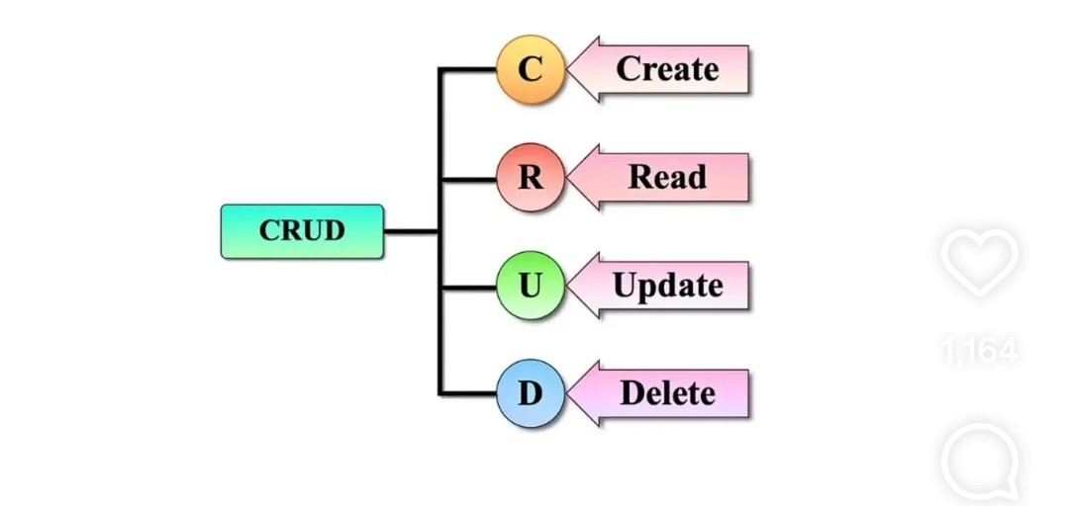
MongoDB Query Language (CRUD)
CRUD (Create, Read, Update, and Delete) operations in MongoDB are the basic set of operations that allow users to interact with the MongoDB server.

Slide 92
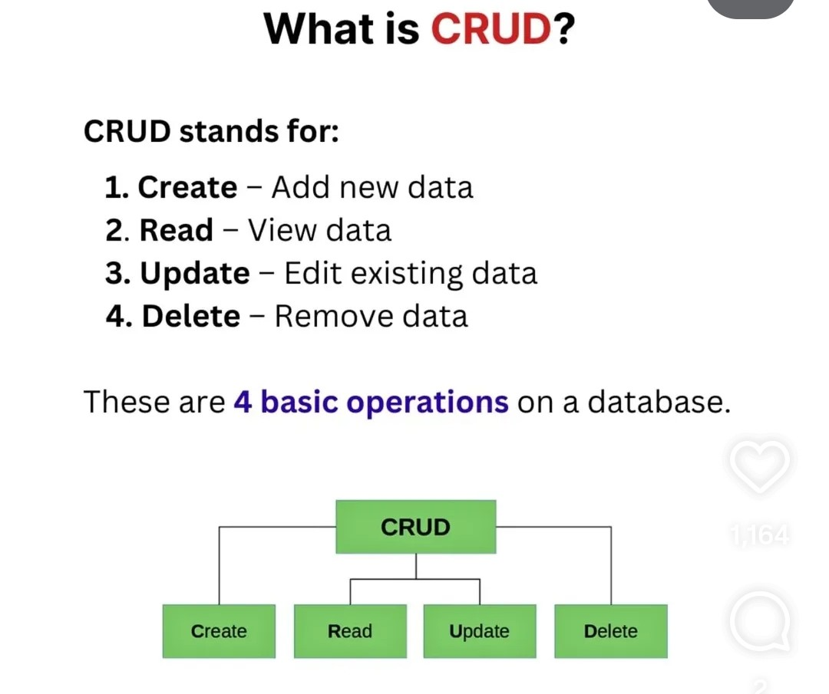
MongoDB Query Language (CRUD)

Slide 93
MongoDB Query Language (CRUD)
1. Create: (Insert Data)
  Used to insert documents (records) into a collection (Table).
  If the collection (table) does not currently exist, insert operations will create the collection (table).
MongoDB provides the following methods to insert documents into a collection:
  db.collecetion.insertOne() // insert single document into collection
  db.collecetion.insertMany() // to insert multiple documents into a collection

Slide 94
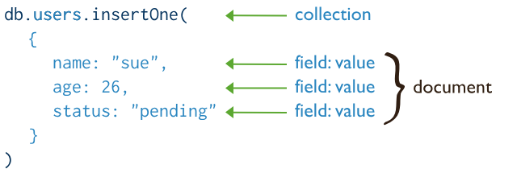
MongoDB Query Language (CRUD)
1. Create:
Example:

Slide 95
MongoDB Query Language (CRUD)
1. Create:
Example:
db.students.insertOne({ name: "Rahul", age: 21, course: "CSE" });
db.students.insertMany([
{ name: "Anu", age: 20, course: "IT" },
{ name: "Vikram", age: 22, course: "ECE" }
]);

Slide 96
MongoDB Query Language (CRUD)
Read Operations:
Read operations retrieve documents from a collection
MongoDB provides the following methods to read documents from a collection:
db.collection.find() -- // Returns all documents
db.collection.find({ key: value }); // Filtered documents

Slide 97
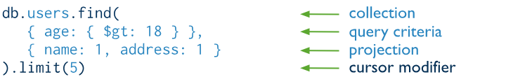
MongoDB Query Language (CRUD)
Read Operations:
db.students.find(); // All students
db.students.find({ course: "CSE" }); // Students in CSE

Slide 98
MongoDB Query Language (CRUD)
Update Operations:
Used to modify existing documents in a collection.
MongoDB provides the following methods to update documents of a collection:
  db.collecetion.updateOne() -- update the first document that matches the query provided. db.collecetion.updateMany() -- update the all document that matches the query provided.

Slide 99
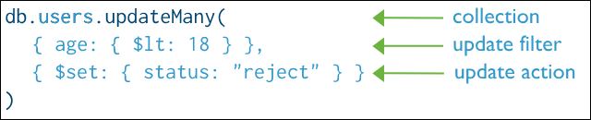
MongoDB Query Language (CRUD)
Update Operations:

Slide 100
MongoDB Query Language (CRUD)
Delete Operations:
Used to delete documents from a collection.
MongoDB provides the following methods to delete documents of a collection:
  db.collection.deleteOne(filter) -- delete the first document that matches the query provided.
  db.collection.deleteMany(filter) -- delete the all document that matches the query provided.

Slide 101
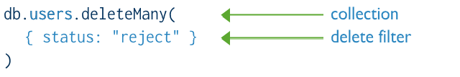
MongoDB Query Language (CRUD)
Delete Operations:

Slide 102
MongoDB Query Language (CRUD)
Question 1:
Apply CRUD operations in MongoDB with suitable examples. Create a STUDENT collection and demonstrate how to:
    Insert multiple student documents
    Retrieve students whose marks are above 80
    Update a student’s department
    Delete students with attendance less than 75%

Slide 103
MongoDB Query Language (CRUD)
✅ Create a Collection
use collegeDB // Switch to database (or create if not exists)

Slide 104
MongoDB Query Language (CRUD)
1️⃣ Insert multiple student documents:
db.STUDENT.insertMany([
{ RollNo: 101, Name: "Arun", Dept: "CSE", Marks: 85, Attendance: 90 },
{ RollNo: 102, Name: "Divya", Dept: "ECE", Marks: 78, Attendance: 88 },
{ RollNo: 103, Name: "Karthik", Dept: "IT", Marks: 92, Attendance: 70 },
{ RollNo: 104, Name: "Meena", Dept: "CSE", Marks: 65, Attendance: 60 },
{ RollNo: 105, Name: "Vishal", Dept: "EEE", Marks: 81, Attendance: 80 }
])

Slide 105
MongoDB Query Language (CRUD)
2️⃣ Retrieve students whose marks are above 80:
db.STUDENT.find({ Marks: { $gt: 80 } })
3️⃣ Update a student’s department
(Example: Change Dept of RollNo 105 from EEE to MECH)
      db.STUDENT.updateOne(
      { RollNo: 105 },
      { $set: { Dept: "MECH" }
      )

Slide 106
MongoDB Query Language (CRUD)
4️⃣ Delete students with attendance less than 75%
db.STUDENT.deleteMany({ Attendance: { $lt: 75 } )

Slide 107
MongoDB Query Language (CRUD)
Example: 2
Demonstrate CRUD operations by creating an EMPLOYEE collection. Write MongoDB queries to:
    Insert employee records (with fields: EmpID, Name, Dept, Salary)
    Display all employees working in the ‘IT’ department
    Increase salary by 10% for employees with salary less than 30000
    Delete an employee record with a specific EmpID

Slide 108
MongoDB Query Language (CRUD)
✅ Create
use companyDB // Creates/uses the database
1️⃣ Insert employee records
db.EMPLOYEE.insertMany([
{ EmpID: 201, Name: "Arun", Dept: "IT", Salary: 28000 },
{ EmpID: 202, Name: "Divya", Dept: "HR", Salary: 35000 },
{ EmpID: 203, Name: "Karthik", Dept: "IT", Salary: 27000 },
{ EmpID: 204, Name: "Meena", Dept: "Finance", Salary: 40000 },
{ EmpID: 205, Name: "Vishal", Dept: "IT", Salary: 50000 }
])

Slide 109
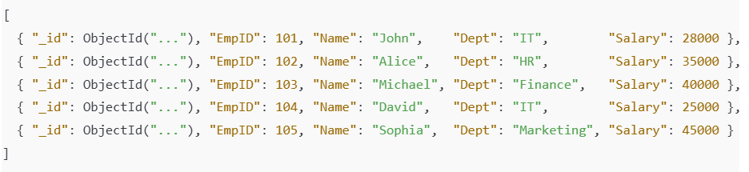
MongoDB Query Language (CRUD)
📌 Initial Data (after insertMany) (i.e output))

Slide 110
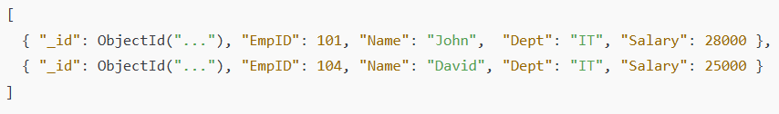
MongoDB Query Language (CRUD)
2️⃣ Display all employees working in the ‘IT’ department
db.EMPLOYEE.find({ Dept: "IT" })
Output:

Slide 111
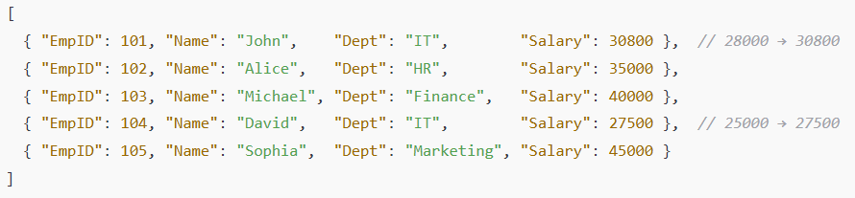
MongoDB Query Language (CRUD)
3️⃣ Increase salary by 10% for employees with salary less than 30000
          db.EMPLOYEE.updateMany(
          { Salary: { $lt: 30000 } },
          { $mul: { Salary: 1.10 } }
          )
$mul multiplies the existing salary by 1.10 (10% increment).

Slide 112
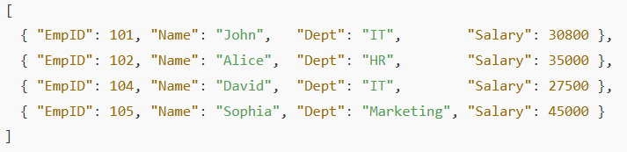
MongoDB Query Language (CRUD)
4️⃣ Delete an employee record with a specific EmpID (Example: EmpID = 202)
db.EMPLOYEE.deleteOne({ EmpID: 202 })
Applied all four CRUD operations:
Create → insertMany()
Read → find()
Update → updateMany()
Delete → deleteOne()

Slide 113
MongoDB Query Language (CRUD)
Example: 3 (Home Work)
Construct a MongoDB program that implements CRUD operations for a PRODUCT collection. Show how to:
    Add product details (ProductID, Name, Price, Stock)
    Retrieve products with stock less than 50
    Update the price of a specific product
    Remove products that are out of stock

Slide 114
MongoDB Query Language (CRUD)
Example: 4 (Home Work)
Apply CRUD operations on a LIBRARY collection. Write MongoDB commands to:
    Insert 5 documents of books (BookID, Title, Author, Year, Copies)
    Retrieve books published after 2015
    Update the number of copies for a given book
    Delete books written by a particular author

Slide 115
HIVE
What is Hive?
Apache Hive is a data warehouse system built on top of Hadoop.
It allows you to query and analyze large datasets stored in HDFS (Hadoop Distributed File System) using a SQL-like language called HiveQL.
Hive was originally developed at Facebook to make Hadoop more accessible to analysts familiar with SQL.

Slide 116
HIVE
Key Features of Hive:
SQL-like interface (HiveQL) → Easier for people who know SQL.
Batch processing → Converts queries into MapReduce, or Spark jobs.
Schema on Read → Data is loaded as-is, schema applied when queried.
Supports large datasets → Terabytes to petabytes.
Extensibility → User-defined functions (UDFs) can be added.

Slide 117
HIVE
Advantages:
Makes Hadoop accessible for SQL users.
Handles huge datasets.
Integration with HDFS, HBase, Spark.
Good for ETL (Extract, Transform, Load).

Slide 118
HIVE
Limitations:
Not real-time → Hive is designed for batch processing (minutes to hours).
High latency → Not suitable for OLTP (online transaction processing).

Slide 119
HIVE ARCHITECTURE
Hive sits on top of Hadoop and translates HiveQL queries into MapReduce for execution.
🔑 Main Components:
User Interface (UI)
Driver
Metastore
Execution Engine
Hadoop Components

Slide 120
HIVE ARCHITECTURE
1. User Interface (UI):
Interfaces to interact with Hive.
Types:
  CLI (Command Line Interface)
  Web UI
  JDBC/ODBC (for BI tools like Tableau, Power BI)

Slide 121
HIVE ARCHITECTURE
2. Driver:
Manages the lifecycle of a HiveQL query.
Sub-components:
  Parser → Checks syntax and converts HiveQL to an Abstract Syntax Tree (AST).
  Planner/Compiler → Generates a logical plan (query execution plan).
  Optimizer → Optimizes the plan (e.g., reduces MapReduce jobs).
  Executor → Sends the job to Hadoop (MapReduce).

Slide 122
HIVE ARCHITECTURE
3. Metastore
Stores metadata about tables, partitions, schemas, and data locations.
4. Execution Engine
Executes the query plan.
Converts HiveQL → MapReduce/Tez/Spark jobs.
5. Hadoop Components
HDFS → Storage of data.
YARN/MapReduce → Actual query execution engine.

Slide 123
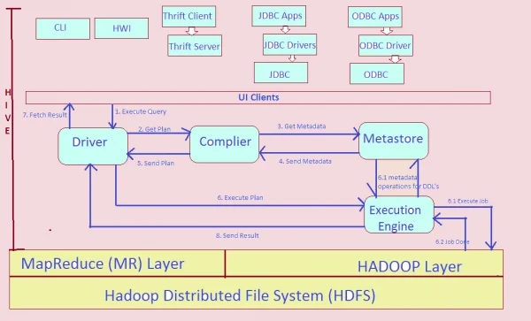
HIVE ARCHITECTURE
So, Hive acts like a bridge between SQL-like queries and Hadoop’s big data processing.

Slide 124
HIVE ARCHITECTURE
Workflow of a Hive Query
User submits HiveQL query via CLI/ODBC/JDBC.
Driver parses and compiles the query.
Metastore provides metadata (tables, schema, partitions).
Optimizer creates the best execution plan.
Execution Engine runs jobs on Hadoop (MapReduce/Tez/Spark).
Results returned to user.

Slide 125
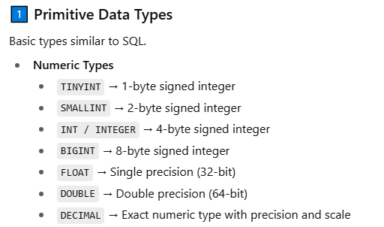
HIVE Data Types
Hive supports three categories of data types: Primitive, Complex, and Null.

Slide 126
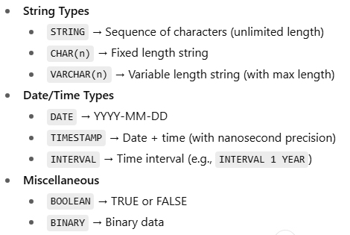
HIVE Data Types
Hive supports three categories of data types: Primitive, Complex, and Null.

Slide 127

HIVE Data Types
Hive supports three categories of data types: Primitive, Complex, and Null.

Slide 128

HIVE Data Types
Hive supports three categories of data types: Primitive, Complex, and Null.

Slide 129
HIVE Data Types
Summary
Category | Types
Numeric | TINYINT, SMALLINT, INT, BIGINT, FLOAT, DOUBLE, DECIMAL
String | STRING, CHAR, VARCHAR
Date/Time | DATE, TIMESTAMP, INTERVAL
Other | BOOLEAN, BINARY
Complex | ARRAY, MAP, STRUCT, UNIONTYPE
Null | NULL

Slide 130
Hive Query Language (HQL)
HQL is the SQL-like language used in Apache Hive to query and manage data stored in HDFS.
It is very similar to SQL.

Slide 131
Hive Query Language (HQL)
Main Features of HQL
SQL-like syntax → Easy for users familiar with RDBMS.
Supports DDL (Data Definition Language), DML (Data Manipulation Language), and Query statements.
Runs queries on top of Hadoop (MapReduce / Spark).
Works with structured, semi-structured, and unstructured data.

Slide 132

Hive Query Language (HQL)
Types of HQL Commands:
  1. Data Definition Language (DDL)
    Used to define database objects.

Slide 133

Hive Query Language (HQL)
Types of HQL Commands:
  1. Data Definition Language (DDL)
    Used to define database objects.

Slide 134

Hive Query Language (HQL)
Types of HQL Commands:
2. Data Manipulation Language (DML)
      Used for inserting, loading, and querying data.
This command is used in Hive to load bulk data from an external file (CSV, TXT, etc.) directly into the table.

Slide 135

Hive Query Language (HQL)
Types of HQL Commands:
2. Data Manipulation Language (DML)
      Used for inserting, loading, and querying data.

Slide 136

Hive Query Language (HQL)
Types of HQL Commands:
3. Query statements:
Table
Result
id | name | marks
---+--------+-------
1 | John | 85.5
2 | Alice | 65.0
3 | Bob | 72.0
name | marks
-------+-------
John | 85.5
Bob | 72.0

Slide 137

Hive Query Language (HQL)
Types of HQL Commands:
3. Query statements:
Table
Result
id | name | age | marks
---+--------+-----+-------
1 | John | 20 | 85.5
2 | Alice | 21 | 65.0
3 | Bob | 20 | 72.0
4 | Mary | 21 | 90.0
age | count
----+------
20 | 2
21 | 2

Slide 138

Hive Query Language (HQL)
Types of HQL Commands:
3. Query statements:
JOIN → Combines data from multiple tables using a condition.
Student Table
Mark Table
Result
id | name
---+-------
1 | John
2 | Alice
3 | Bob
id | subject | marks
---+---------+------
1 | Math | 85
2 | Science | 92
3 | Math | 76
name | subject | marks
-------+---------+------
John | Math | 85
Alice | Science | 92
Bob | Math | 76

Slide 139

Hive Query Language (HQL)
Types of HQL Commands:
3. Query statements:
ORDER BY → Sorts query results (either ascending or descending).
Student Table
Result
id | name | marks
---+--------+------
1 | John | 85
2 | Alice | 92
3 | Bob | 76
id | name | marks
---+--------+------
2 | Alice | 92
1 | John | 85
3 | Bob | 76

Slide 140

Hive Query Language (HQL)
Types of HQL Commands:
3. Other statements:
A VIEW is like a virtual table created from the result of a query
SELECT * FROM high_scorers;
id | name | marks
---+--------+------
1 | John | 85
2 | Alice | 92
3 | Bob | 76
name | marks
-------+------
John | 85
Alice | 92

Slide 141

Hive Query Language (HQL)
Types of HQL Commands:
3. Other statements:
splitting a single logical table into multiple physical sub-tables
It tells the database to partition the sales table using the year and month columns.

Slide 142
Hive Query Language (HQL)
Summary:
HQL ≈ SQL but for Big Data on Hadoop.
Supports DDL, DML, Joins, Views, Partitions, Bucketing.
Queries are internally converted to MapReduce/Spark jobs.

Slide 143
Hive Query Language (HQL)
    Difference Between HiveQL and SQL
SQL (RDBMS) | HiveQL (Big Data)
Works on structured data | Works on big structured/semi-structured data
Executes immediately | Generates MapReduce/Tez/Spark jobs
Row-based storage | Mostly columnar/partitioned storage
Transactions supported | Not transaction-oriented (batch-oriented)

Slide 144


